Slide 1


[Cost of LIVING]

Slide 2


Today's agenda
Project recap
Problem
Process
Insights
Project
Summary

Slide 3

data.
This project revolves around the analysis of the cost of living in various cities and countries across the
globe.
I begun an Analysis focusing on these tasks:
. Data preprocessing and cleaning to ensure data quality.
. Exploratory data analysis (EDA) to identify trends, outliers.
. Interpretation of the results to draw meaningful conclusions.
Project Recap

Slide 4

Problem
Over 215 Countries, and
4898 Cities.
More than 50 cost-related variables determine the Cost of Living
But how to capitalize on it when there is so much?
Analysis to find the highest and lowest cost of living by cities and countries

Slide 5
Process
1
Data Understanding
2
Data Cleaning
3
Data Modelling
4
Data Analysis
5
Uncover Insights

Slide 6

Insights
Major Cost components in a region
Accommodation
Monthly pass
Food expenses
Clothes
Cigarettes & Alcohol
Highest Cost of Living
Iran – Kermanashah
COT : $13,318
Lowest cost of Living
Pakistan – Sukkur
COT : $227

Slide 7
Interactive Report

Slide 8


Slide 9


Slide 10

Major Cost Components % on the Highest cost of lining country (Pakistan)
Major Cost Components % on the Lowest cost of lining country (Pakistan)

Slide 11

High Correlation
Moderate Correlation

Slide 12
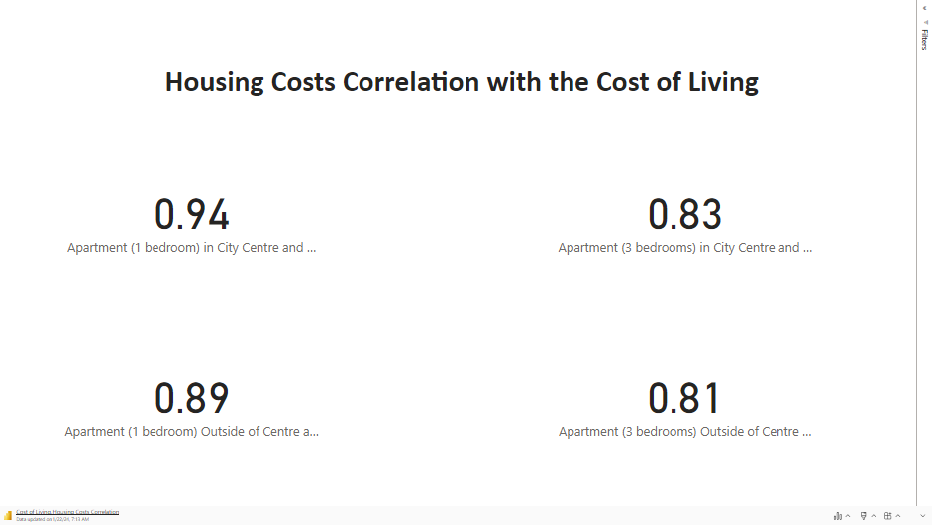
Strong Positive Correlation

Slide 13
In the Analysis process I find a trend between the Price per Square Meter to Buy Apartment in City Centre and outside of the center plus the Monthly Pass (transportation).
In most of the cases as we know the price outside of the City Center is quite lower than in City Center.
However, in some Cities the price is equal and in other cases it’s higher outside of the City Center.
I did investigate more and find out that the cities with a high rate of price per meter in City Center has an affordable low price for Monthly pass, while the cities with no Monthly pass (low public transportation) has almost equal price for Apartment between the City Center and outside of the City Center

Slide 14
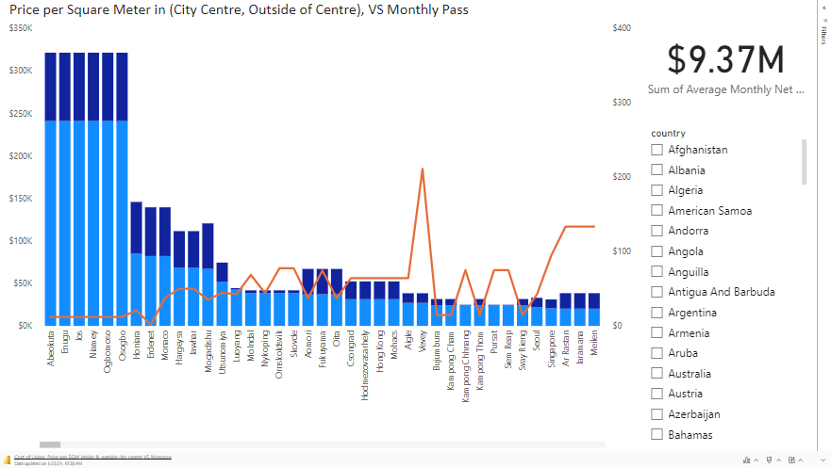

Slide 15
Thank you!

